Slide 1
Steam Enhanced EXTRACTION
Laura Fishman
Anal bhavsar

Slide 2
Thermal remediation
Biological/chemical degradation
Microbial mineralization of napl contaminants
Hydrous pyrolysis oxidation
Hydrolysis at elevated temp.
Physical removal
Increase vapor pressure
Increase solubility
Reduce adsorption coefficients
Reduce napl viscosity

Slide 3
Non-aqueous phase liquid (napl)
The portion of an organic contaminant that exists in a separate immiscible liquid phase when in contact with water or air

Slide 4
DNAPL: difficult to locate and characterize in the subsurface DIFFICULT TO REMEDIATE
high specific gravity– ACCUMULATE AT THE IMPERMEABLE LAYER
low solubility
tendency to remain sorbed to organic materials
conventional remedial technologies such as pump-and-treat ARE INEFFECTIVE

Slide 5
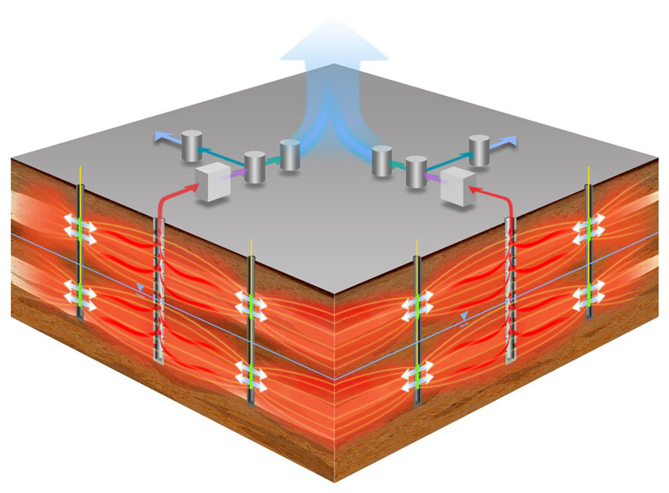
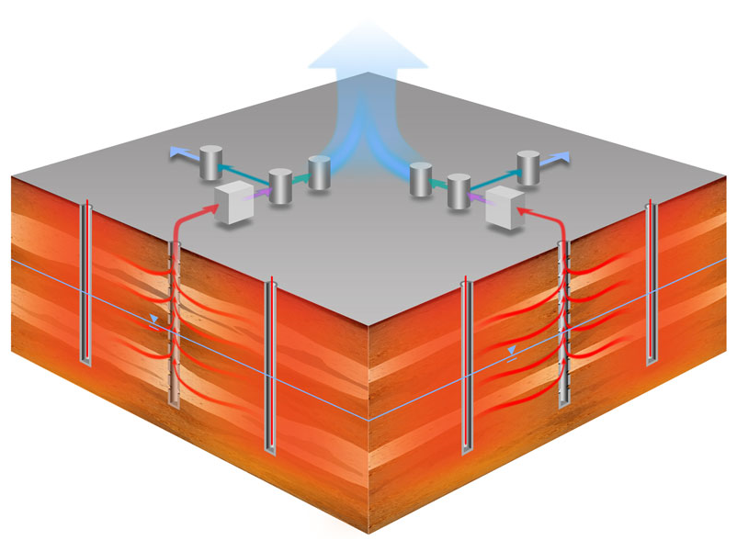
Thermal remediation
ERH
ELECTRICAL RESISTANCE HEATING
TCH
THERMAL CONDUCTIVE HEATING

Slide 6
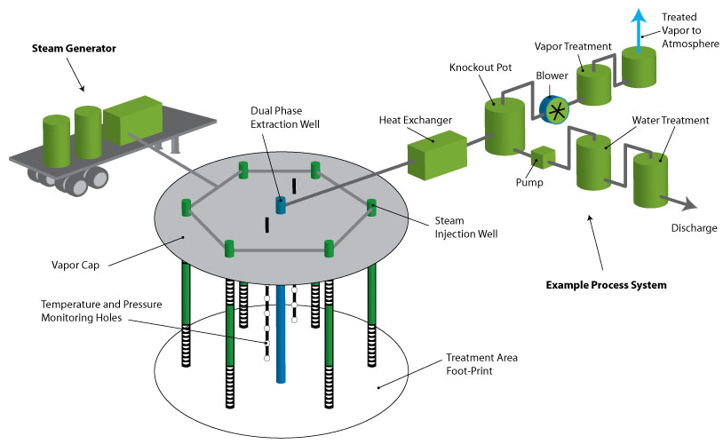
Steam enhanced extraction (SEE)

Slide 7
CO-INJECTING AIR
Reduces the risk of condensation banks forming
Enhances vapor transport
Enhances chemical degradation
Introducing an excess of oxygen to previously steam-heated subsurface initiates hydrous pyrolysis oxidation

Slide 8
PRESSURE CYCLING
VARYING THE RATES OF STEAM INJECTION AND Extraction
Greater contaminant mobility at depressurization
Greater heat transfer at pressurization

Slide 9
COMBINING METHODS – SEE & ERH YOUNG-RAINEY STAR CENTER, LARGO, FLORIDA
SANDY AQUIFER UNDERLAIN BY A CLAY LAYER
SEE IS MORE EFFECTIVE IN SAND, ERH IS MORE EFFECTIVE IN CLAY
PRESSURE CYCLING
AIR CO-INJECTION
REMEDIAL EFFICIENCES BETWEEN 99.85% AND 99.99% ACHEIVED

Slide 10
Young-rainey star center, largo, fl
Contaminants of concern
TCE
Toluene
CIS-1,2-dCE
Methylene chloride
Petroleum range organics

Slide 11
Loring air force base, limestone, maine
Fractured bedrock
Lower transmissivity than expected
Remediation efforts were stopped after 45 days
Limited contaminant removal
air co-injection significantly increased Contaminant removal rate

Slide 12
Loring air force base, limestone, maine
Contaminants
PCE (dnapl)
Vocs
diesel range organics
gasoline range organics

Slide 13
a.g. communications systems, northlake, illinois
clay and sand till, with intermittent sand and silt layers
65 steam injection wells installed in shallow and deep permeable zones
Tce & dce concentrations reduced by more than 90%
pressure cycling increased removal rate

Slide 14
a.g. communications systems, northlake, illinois
Dnapl Contaminants
tCE
Dce
Lnapl Contaminants
xylene
benzene

Slide 15
Cost Benefit Analysis:
Electrical Resistive Heating:
Location: Cape Canaveral, Florida
Period of Operation: August 18, 1999 to July 12, 2000
Plot area: 3750 sq. ft. (75X 50 X 45 ft )
Source and amount of contamination: cleaning operation of the rocket engine and its parts; with total of 11,313 kg TCE and other halogenated VOCs.
ERH method using 13 electrodes and by applying total 1.7 million kW-hrs of energy to the subsurface was implied.
Around 90% of TCE and 97% of DNAPL were removed.
The total project cost was $613,000, including costs for design, equipment, mobilization/demobilization, and operation.
Notes:
15

Slide 16
In Situ Chemical Oxidation:
Location: Cape Canaveral, Florida
Period of Operation: September 8, 1999 to April 17, 2000
Plot area and source of contaminants: Same as the one mentioned in the Electrical Resistive Heating field test .
Amount of Contaminant: 6,122 kg TCE concentration and 5,039 kg of the TCE mass DNAPL.
Chemical oxidation using a total of 842,985 gal of permanganate solution (1.4 to 2 percent) was injected into the test plot in 3 phases over a period of 8 months.
Approximately 77% of TCE and 76% of DNAPL was removed.
The total cost for this field demonstration was approximately $1 million, including costs for design, procurement, equipment and oxidant, mobilization/demobilization, and process monitoring.
Notes:
16

Slide 17
In Situ Surfactant-Enhanced DNAPL Flushing
Location: Camp Lejeune, NC
Period of Operation: April - August 1999
Plot area: 600 sq. ft (20X 30X 20 ft)
Amount of contaminants: Approximately 105 gallons of DNAPL mainly consists of Chlorinated Solvents and Total Petroleum Hydrocarbons (TPH).
For the treatment, solution of a surfactant, calcium chloride, isopropyl alcohol, and water was injected through 3 injection wells at a rate of 0.133 gallons per minute (gpm) per well for 58 days;
As above-ground treatment, gravity separation to remove separate phase DNAPLs, pervaporation to remove dissolved-phase contaminants, and ultrafiltration (UF) to reconcentrate surfactant fluid were used.
A total of 76 gal of PCE were recovered and approximately 77% of DNAPL was removed
Total demonstration costs were $3.1 million, including zone characterization, surfactant selection, well field installation, removal equipment, pre-treatment, application of the technology, and surfactant regeneration.
Notes:
17

Slide 18
Steam Enhanced Extraction:
Location: Northlake, IL
Period of Operation: September 1995 to November 1999
Plot area: 250,000 ft2 and a depth of about 50 ft
Contaminants: Chlorinated solvents (TCE, cis-1,2-DCE with greater than 45,000ug/L concentration), and petroleum hydrocarbons (xylene and benzene).
Geological formation: alternating clay and sand till, with intermittent sand and silt layers.
The system included injection wells, vapor extraction wells, groundwater extraction wells, and two vacuum extraction units.
Around 33,000 lbs of hydrocarbons were removed and thus reducing TCE and DCE concentrations by more than 90%.
The project cost was $4.9 million, including the cost of the pilot test, system design and installation, five years of operation and maintenance.
Notes:
18

Slide 19
Summary of Cost Benefit Analysis:
Sr. No. | Treatment method | Test area | Geological formation | Duration of project | % Removal | Total Cost
1. | Electrical Resistive Heating | 3750 sq. ft (75X 50X 45 ft) | Sand -Fine Grained - Sand | 11 months | 97% | $613,000
2. | Chemical Oxidation | 3750 sq. ft (75X 50X 45 ft) | Sand -Fine Grained - Sand | 7 months | 76% | $1 million
3. | Surfactant Enhanced Flushing | 600 sq. ft (20X 30X 20 ft) | Fine sand- Silt- Clayey silt | 4 months | 77% | $3.1 million
4. | Steam Enhanced Remediation | 250,000 sq. ft and depth of 50 ft | Clay- Sand and Silt layers- Sand till | 4 years | 90% | $4.9 million
Notes:
19

Slide 20
Conclusions and Recommendations
SEE is most effective in permeable soils, typically sandy layers with low clay and mineral contents
Has been proved incredibly effective when combined with electrical resistance heating (ERH) in sandy aquifers, such as was done at the Young-Rainey STAR Center in Largo, Florida.
The study at the A.G. Communications Systems site in Northlake, Illinois showed that it can also be a viable remediation option for a more clayey site.
SEE is best used for deep contamination sites, but can also be used in shallow sites if a vapor cap is installed, as was done at the Young-Rainey STAR Center. Pressure cycling, varying the steam injection rates and the vacuum and liquid extraction rates, should be incorporated in SEE remediation.
At both the Young-Rainey STAR Center site and the A.G. Communications Systems site, pressure cycling dramatically increased contaminant removal rates.
Air co-injection should also be included with this remediation technique. Air co-injection reduces the risk of condensation bank formation, and enhances vapor transport between injection and extraction points.
This method that doesn’t require any complex equipment and has very simple operation. It requires only a network of wells and borings. Thus, this makes it much easier to get a permit for the remediation work. Many companies that perform remediation offer some form of steam enhanced extraction.
Notes:
20

